Slide 1
SnapGarden Final Presentation
Projektpraktikum Multimedia
Hayri Altinisik, student1@tum.de
Baran Kilic, ge95bid@tum.de
Kenny Nguyen, ge47wof@tum.de

Slide 2
Outline
Gliederung

Slide 3
Project Idea
The Problem:
Beginners struggle to care and maintain healthy plants
Overwatering, pests, and lack of knowledge lead to plant failure
Seasoned Gardeners desire smarter tools
Our Motivation:
Empower plant lovers with AI-powered tools to make plant care effortless
Promote sustainability by encouraging successful plant cultivation
Bridge the gap between technology and nature for eco-conscious living

Slide 4
Project Management, Task Distribution
Frontend (Kenny Nguyen):
Backend (Hayri Altinisik):
Deep Learning (Baran Kilic)

Slide 5
Key Features
Plant Identification:
Snap a photo of any plant, and our AI identifies it instantly
Provides information like plant type, ideal conditions, and common issues
Health Analysis:
Detect signs of pests, diseases, or poot health through photo analysis
Offers actionable advice for treatment and maintenance
Personalized Watering Schedules:
AI calculates the watering needs of each plant based on species
Sends reminders, so users never miss a watering day
User-Friendly Experience:
Easy-to-navigate interface with tips for beginners and tools for experienced gardeners
Works seamlessly across devices for on-the-go support.

Slide 6
Implementation & Challenges
Deep Learning
Which dataset?
Which model? Model Architecture?
Training process?
Performance?
Website
Frontend framework?
Backend framework? (Flask, or more?)
Did you encounter any challenges? How did you solve them?

Slide 7
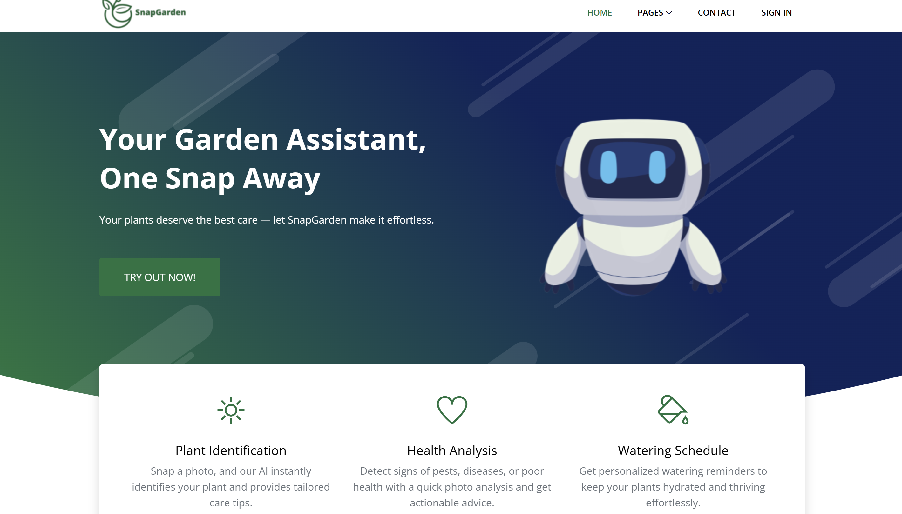
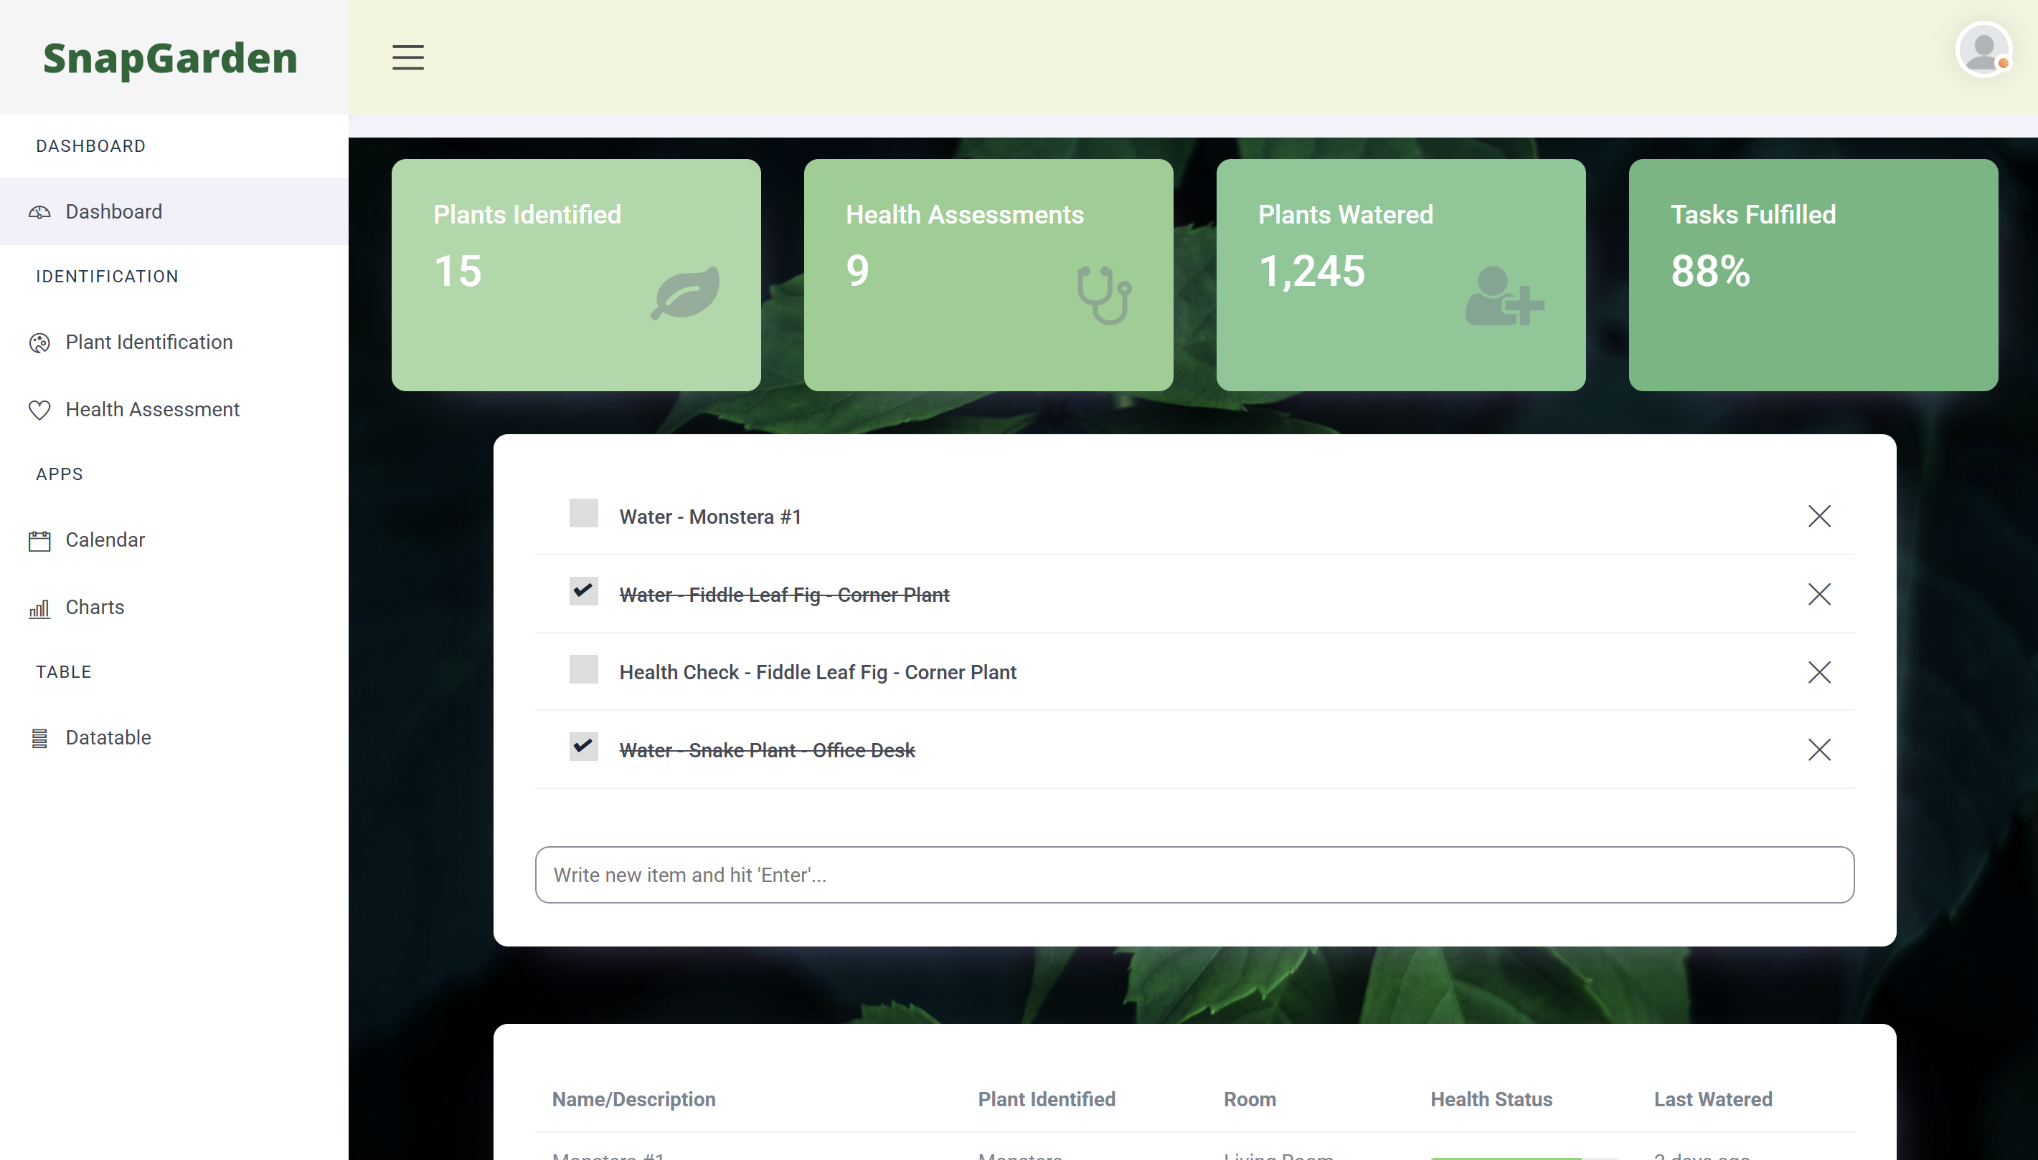
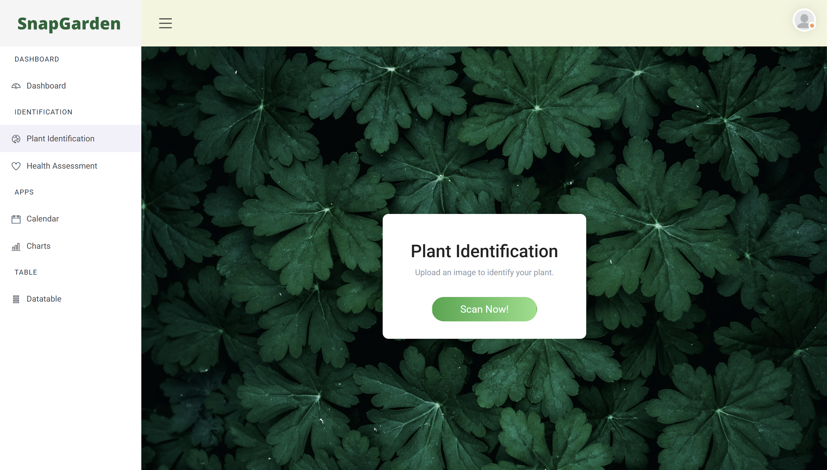
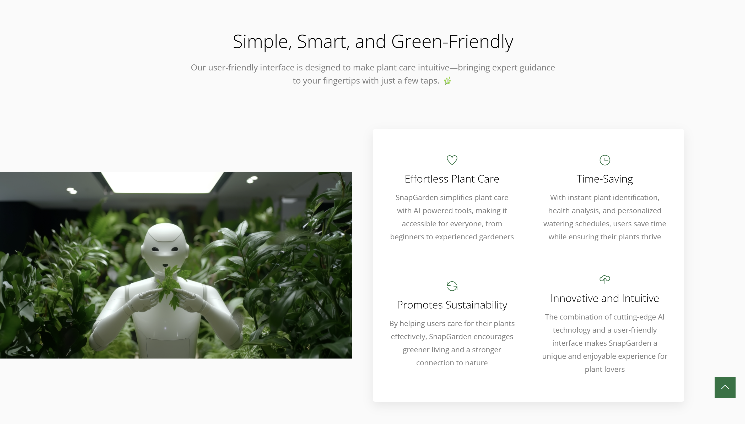

Slide 8
Demo

Slide 9
Goals & Milestones
Revisit your goals in the kick-off slides
Are they fulfilled?

Slide 10
Conclusion

Slide 11
References
Templates for Frontend
https://themefisher.com/products/quixlab-bootstrap
https://themefisher.com/products/small-apps-bootstrap

Slide 12
Thank you for your attention

